Slide 1
Digital Portfolio
STUDENT NAME: S.PARVATHAVARTHINI .
REGISTER NO AND NMID:24131061802522052 autanm106106cs214033
DEPARTMENT: Bsc.Computer science.II nd year
COLLEGE: COLLEGE/ UNIVERSITY :Shree Raghavendra Arts and science college, Annamalai University

Slide 2
PROJECT TITLE
DIGITAL PORTFOLIO

Slide 3


AGENDA
Problem Statement
Project Overview
End Users
Tools and Technologies
Portfolio design and Layout
Features and Functionality
Results and Screenshots
Conclusion
Github Link
3/21/2024 Annual Review

Slide 4

PROBLEM STATEMENT
Student need to present simple way present their skill ,projects and contact details .....
Visual Design & User Experience Added modern color scheme with gradients and shadows Improved typography and spacing for better readability Added subtle animations for a more engaging experience
Content Organization Added a skills section with visual indicators Enhanced project cards with images and technology tags Created a proper contact form instead of just displaying information
. Technical Improvements Made the site more responsive across devices Added interactive elements with JavaScript Improved semantic HTML structure

Slide 5

PROJECT OVERVIEW
This project is a personal portfolio website developed using HTML and CSS. The main goal of this project is to provide a simple, responsive, and user-friendly platform for students or professionals to showcase their personal details, skills, projects, and contact information.
The website is divided into clear sections:
Header – Displays the name, role, and navigation buttons.
About Me – Contains personal introduction and educational background.
Projects – Highlights sample projects in a grid layout.
Contact – Provides email and phone details for communication.
Footer – Adds a closing note with copyright.
The design is clean, professional, and mobile-friendly. This portfolio can be easily customized to suit any student or professional, making it useful for academic submissions, job.

Slide 6

WHO ARE THE END USERS?
👥 End Users
The end users of this program are mainly students, fresh graduates, and professionals who want to present their skills, educational details, and projects in a simple and professional way.
Students can use the portfolio to submit academic projects and showcase their learning.
Job Seekers can use it as an online resume to impress recruiters.
Recruiters/Employers are indirect end users because they can easily view the candidate’s skills, projects, and contact details through the portfolio.
Thus, the program benefits both the creator (student/professional) and the viewer (recruiter/teacher/visitor).

Slide 7

TOOLS AND TECHNIQUES
🔹 Techniques Applied
Responsive Web Design – using media queries for mobile-friendly layout.
Grid Layout – CSS Grid used to arrange projects in columns.
Button Styling – hover effects applied for interactivity.
Sectioning – website divided into Header, About, Projects, Contact, Footer for clarity.
Clean UI/UX Design – simple fonts, proper spacing, and professional color scheme for readability.
✨ This shows both the technology you used and the methods applied to make the program effective.
🔹 Tools Used
HTML5 – for creating the structure of the website (headings, paragraphs, sections).
CSS3 – for styling, layout, colors, fonts, and responsive design.
Text Editor – such as VS Code / Notepad++ for writing the code.
Web Browser – like Chrome, Edge, or Firefox for running and testing the website.

Slide 8
POTFOLIO DESIGN AND LAYOUT
🔹 Design
The portfolio is designed using HTML5 and CSS3.
It follows a clean, minimal, and professional design with blue and white color themes.
Typography – uses Segoe UI font for modern and readable text.
Responsive Design – with media queries so it works on desktops, tablets, and mobiles.
Interactive Buttons – with hover effects to improve the colour
Layout
The portfolio is divided into five main sections:
Header
  Contains the name (“S.Parvathavarthini”), role (Web Developer & Designer), and navigation buttons (View My Work, Contact Me).
About Me Section
  Provides personal introduction, education details, and career interest.
Projects Section
  Displays projects in a two-column grid layout (E-commerce Website, Travel Blog).
  Becomes a single column on smaller screens for mobile responsiveness.
Contact Section
  Shows contact information like email and phone number.
8

Slide 9
FEATURES AND FUNCTIONALITY
Features
1. Responsive Design - The website adjusts to desktop, tablet, and mobile screens
.2. Clean User Interface (UI) - Simple and professional design with a blue theme.
3. Section-Based Layout - Divided into Header, About, Projects, Contact, and Footer.
4. Interactive Buttons - Navigation buttons (View My Work, Contact Me) with hover effects.
5. Grid Project Display - Projects shown in a neat two-column grid(auto-adjusts to one column on small screens).
6. Lightweight Website - Fast loading, as it is built only with HTML and CSS.
⚙️ Functionality
Header Navigation – Provides quick buttons to move to the Projects and Contact sections.
About Section – Displays personal introduction, educational details, and career interests.
Projects Section – Shows project details in a grid layout with titles and short descriptions.
Contact Section – Provides email and phone details for communication.
Footer Section – Displays copyright information.
Responsive Layout – Adjusts automatically for desktop, tablet, and mobile screens using CSS media queries.

Slide 10
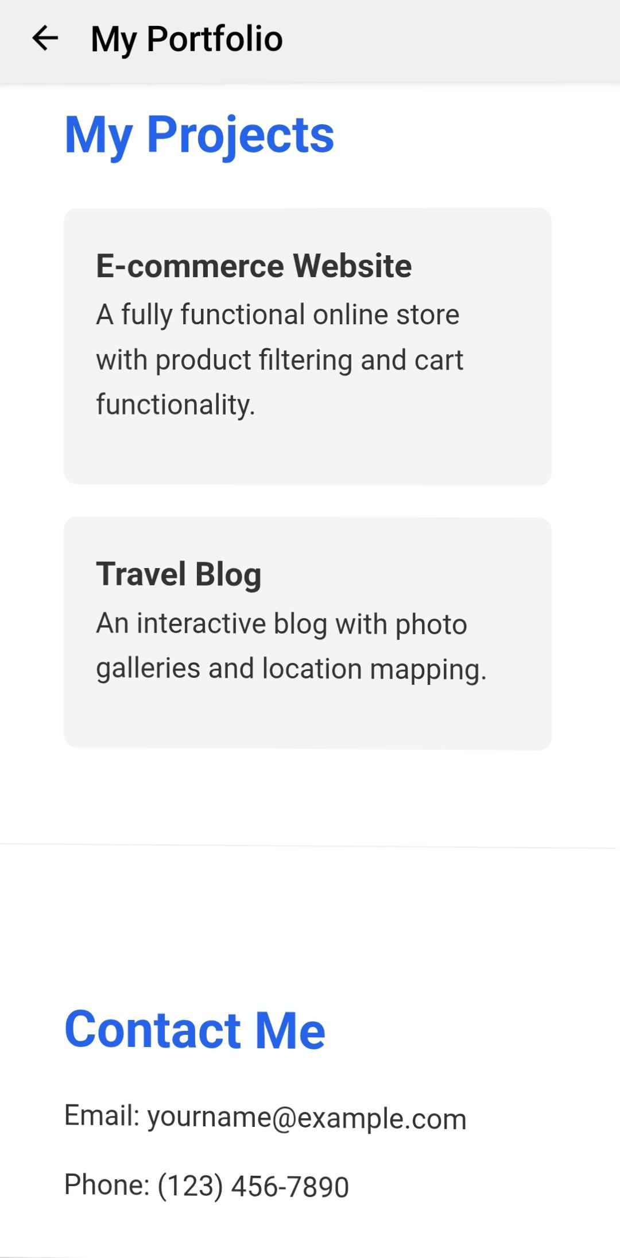
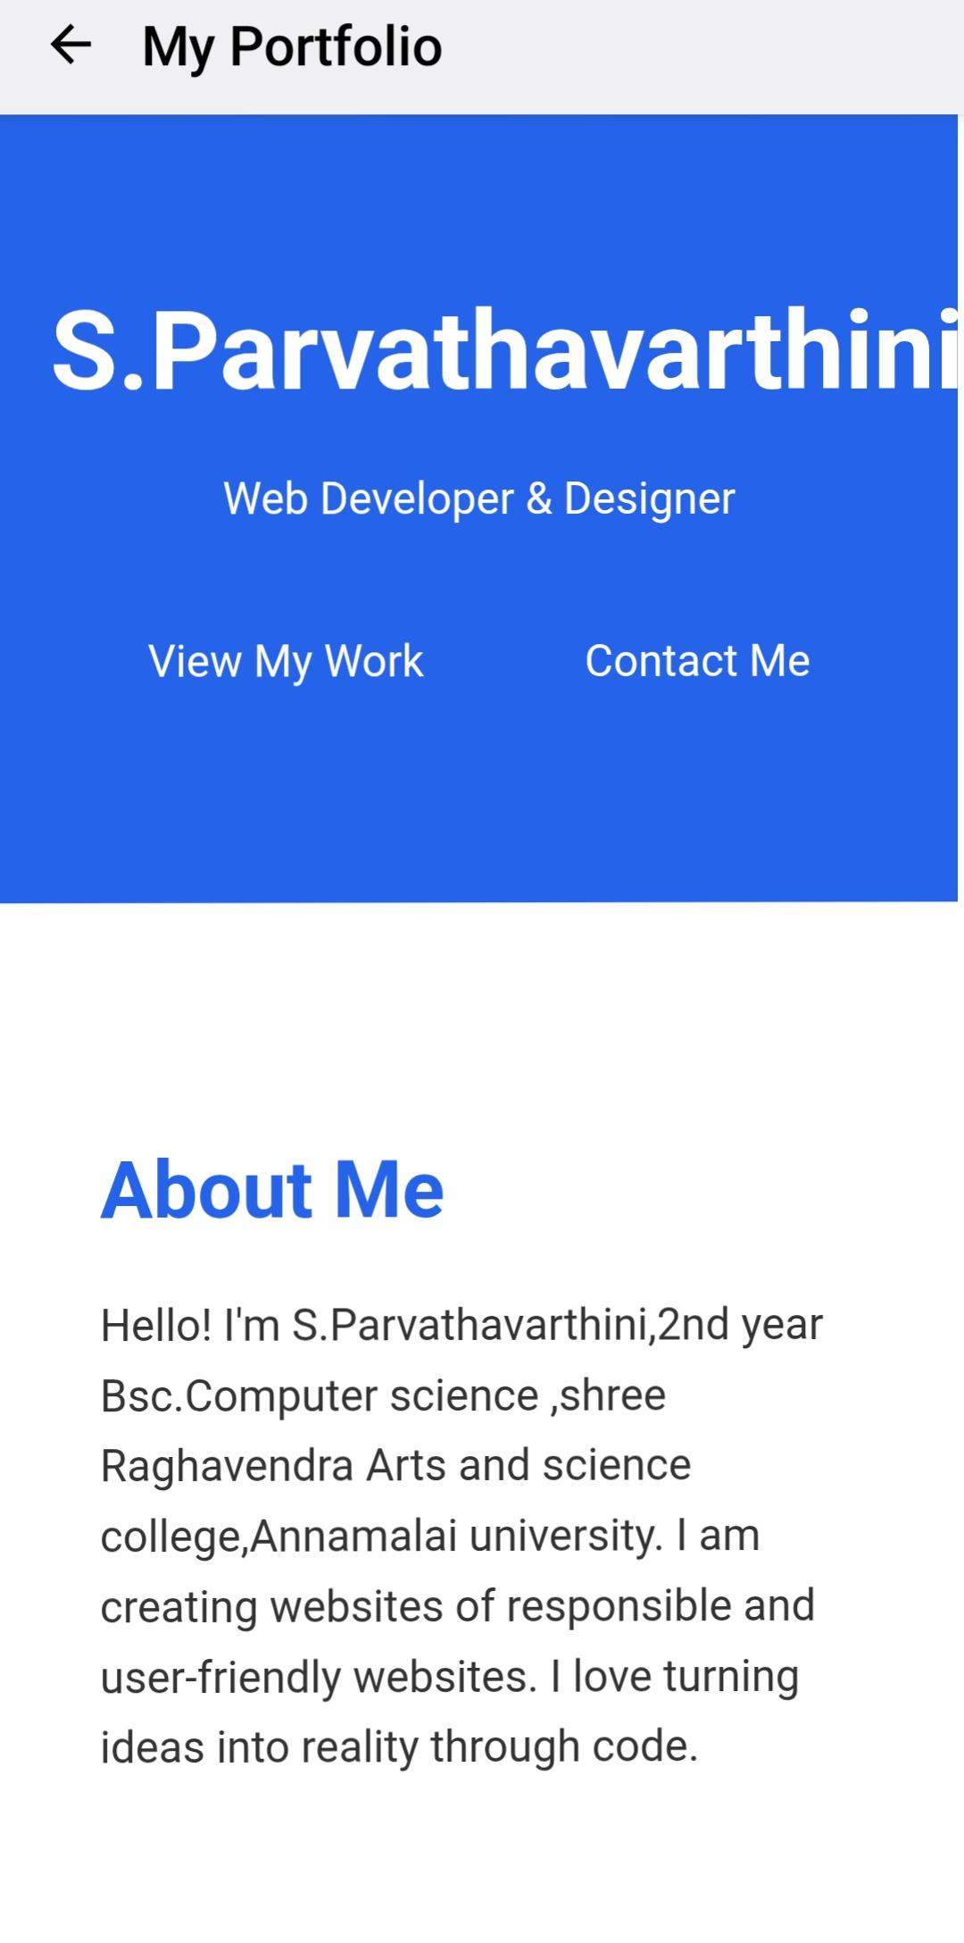

RESULTS AND SCREENSHOTS
3/21/2024 Annual Review
10

Slide 11
CONCLUSION
The portfolio website program successfully provides a simple, responsive, and professional platform for presenting personal details, academic information, and projects. Using only HTML and CSS, the website is lightweight, user-friendly, and mobile-compatible. This project helps students and beginners showcase their skills effectively and can be extended with more features like images, social media links, and advanced styling in the future.
11

